Slide 1

Face and Information Content Detection for Automated Blurring
CSE 509: Digital Video Processing
Group 29
Kuriakose Eldho
(keldho@asu.edu)
Raghav Kapoor
(rkapoo22@asu.edu)
Jisoo Lee
(jlee815@asu.edu)
11.29.2023

Slide 2
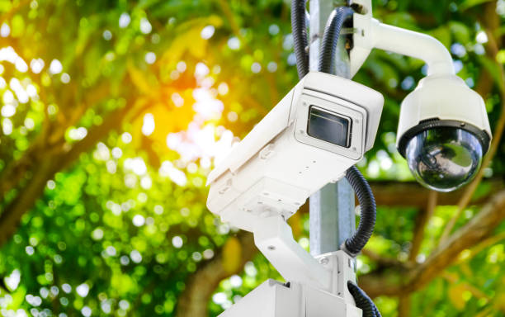
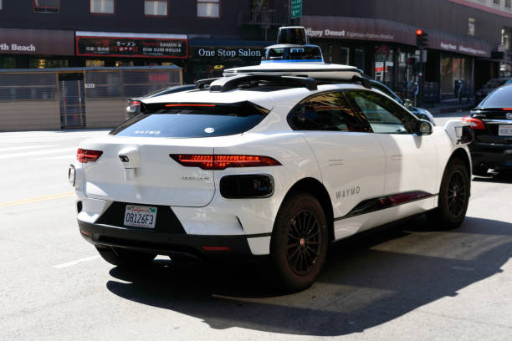
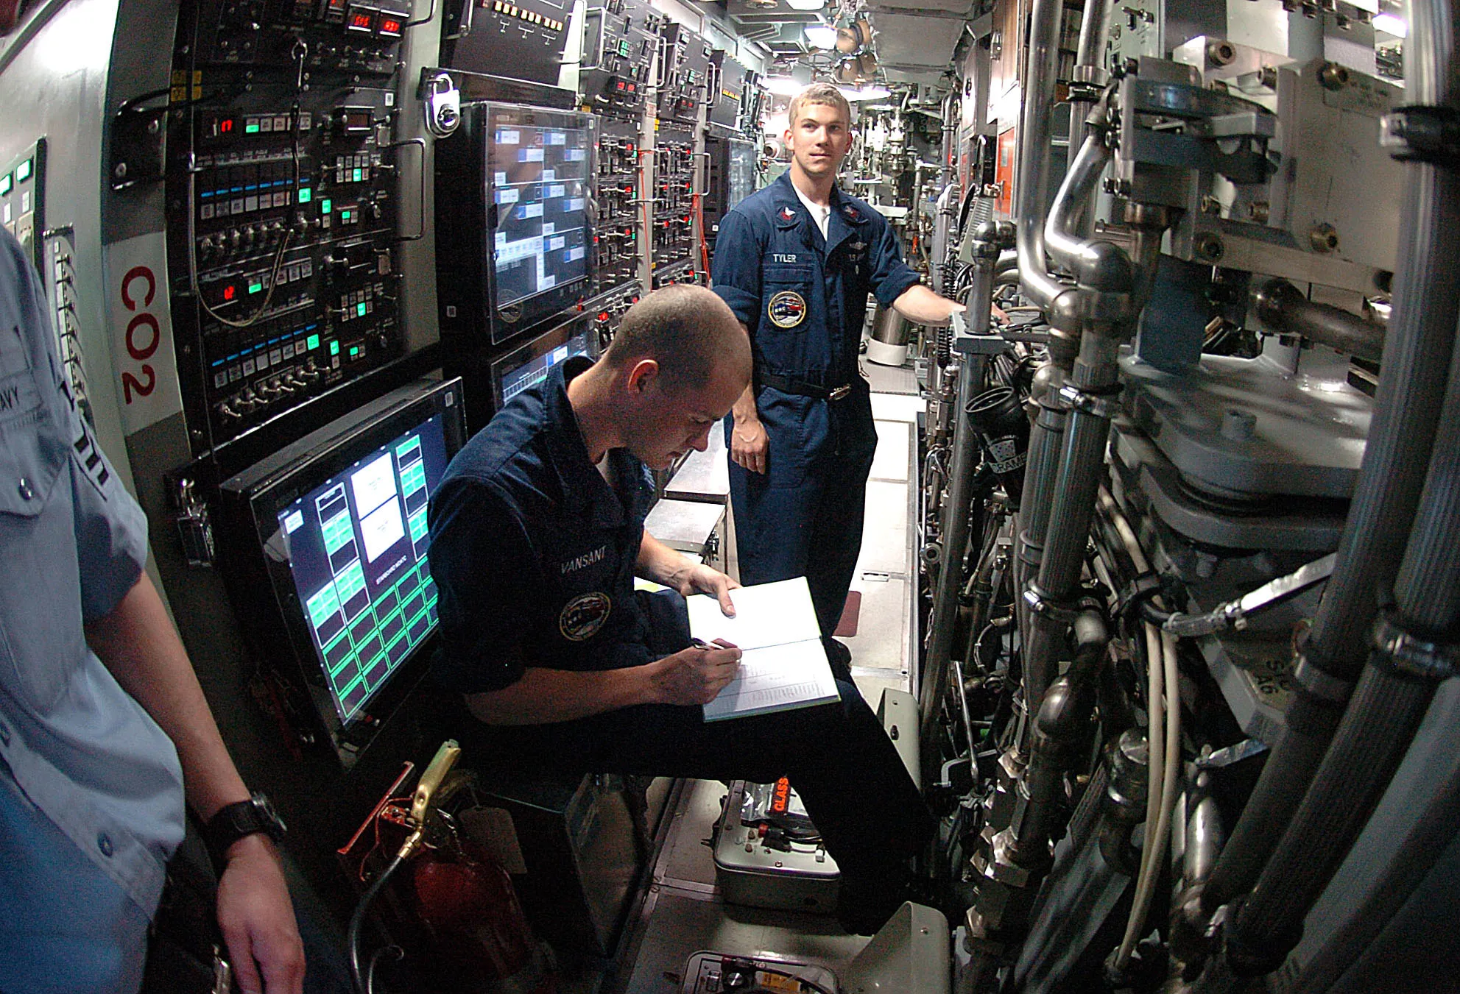
Introduction
With the advancement of artificial intelligence, extensive data collection has become prevalent. However, due to the vast amount of collected data, sensitive information such as people's faces or text may not be adequately protected. Therefore, the goal of this project is to automatically detect sensitive information and apply blurring to ensure its protection.
Notes:
Jisoo

Slide 3
Problem Statement
Our project consists of four main parts:
The first part is object detection. Object detection has two domains: classification and localization. Here we focus on just localization. We identify two kinds of biometric data:
The first segment of our project involves character detection, where a pretrained model within the EasyOCR repository is utilized to discern and locate textual elements in video frames.
Following character detection, the second phase focuses on face detection, aiming to identify and locate human faces within the video content.
The project's third component leverages the temporal nature of consecutive frame detections as time series data using Kalman Filters, enhancing overall detection performance.
The conclusive step entails applying blurring to the bounding boxes derived from these integrated parts.
Notes:
Jisoo

Slide 4
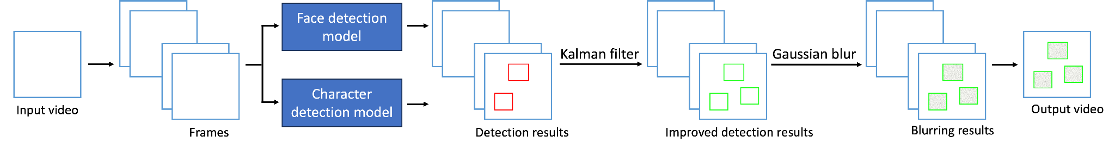
Model Architecture
1
3
4
2
1
Face detector:
3
Kalman filter
2
Character detector: CRAFT
4
Gaussian blur
Notes:
Jisoo

Slide 5
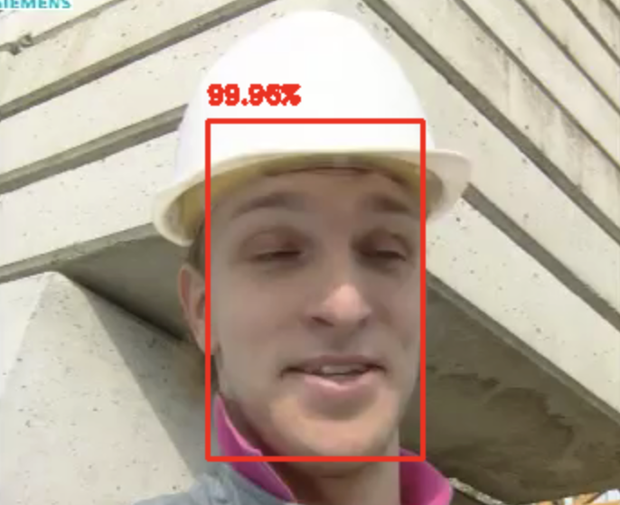
Face Detection
We are using the pre trained DNN Face Detector in OpenCV.
Based on a Single-Shot-Multibox detector and uses ResNet-10 Architecture.
Model was trained using 300x300 pixel resolution images.
Notes:
Kuriakose
Explain Single Shot Multibox detector nd ResNet-10 Architecture

Slide 6
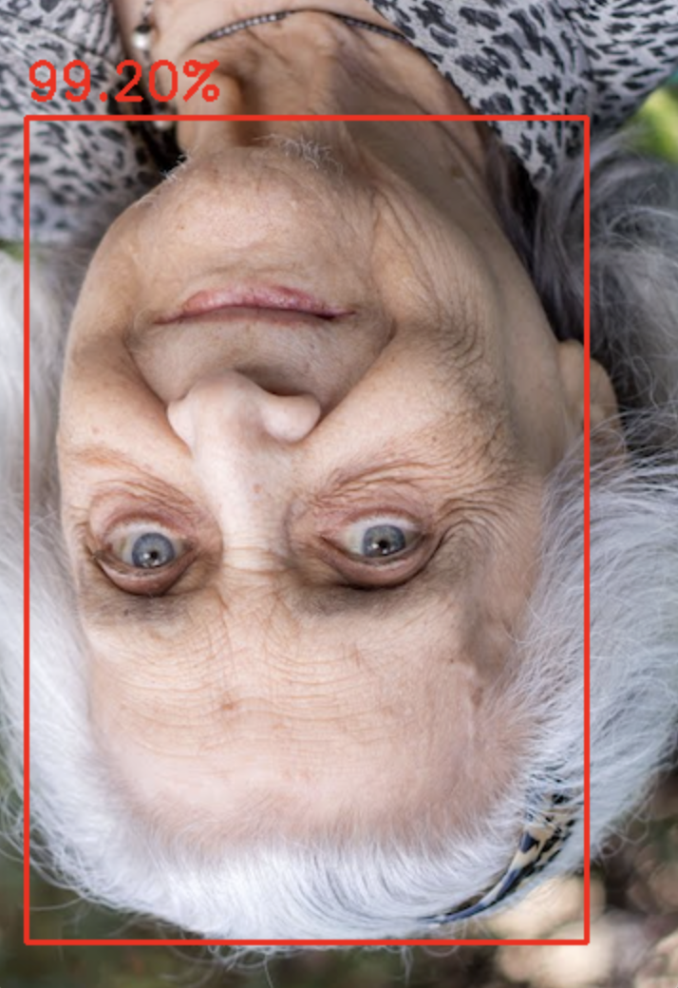
Face Detection
Advantages of this model:
Runs at near real-time on CPU
Detects faces across various scales
Works even under substantial occlusion
Works for different face orientations

Slide 7
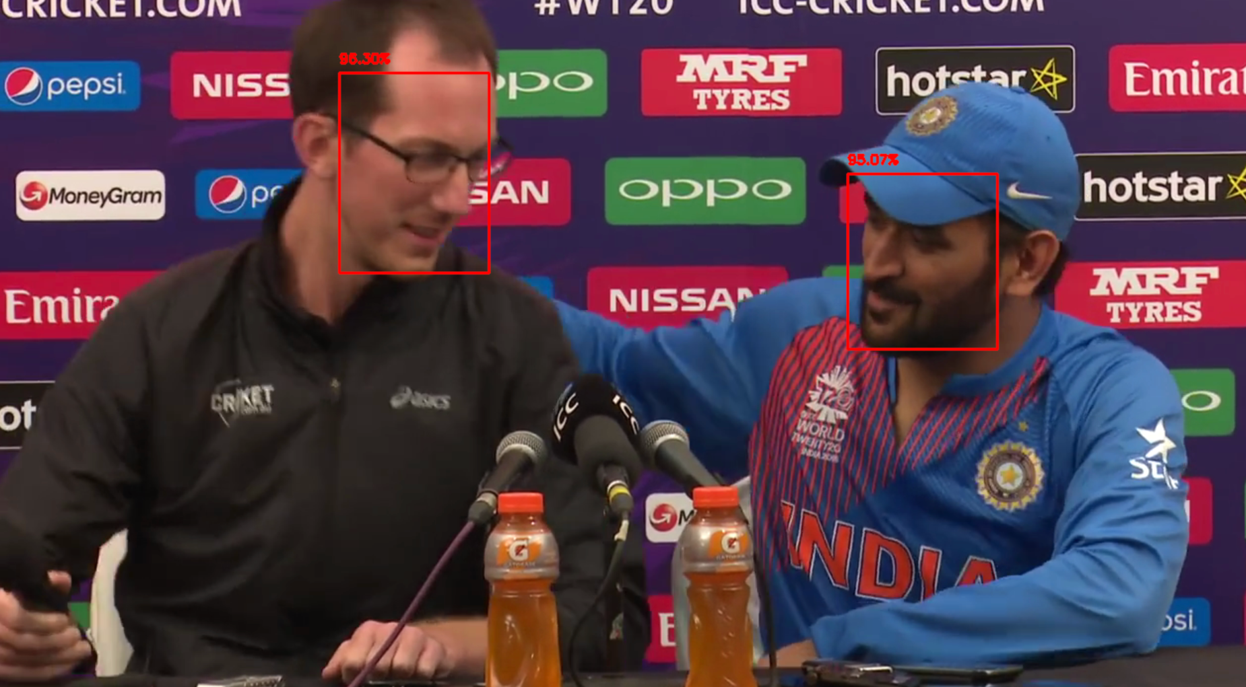
Face Detection

Slide 8
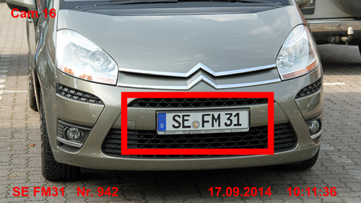
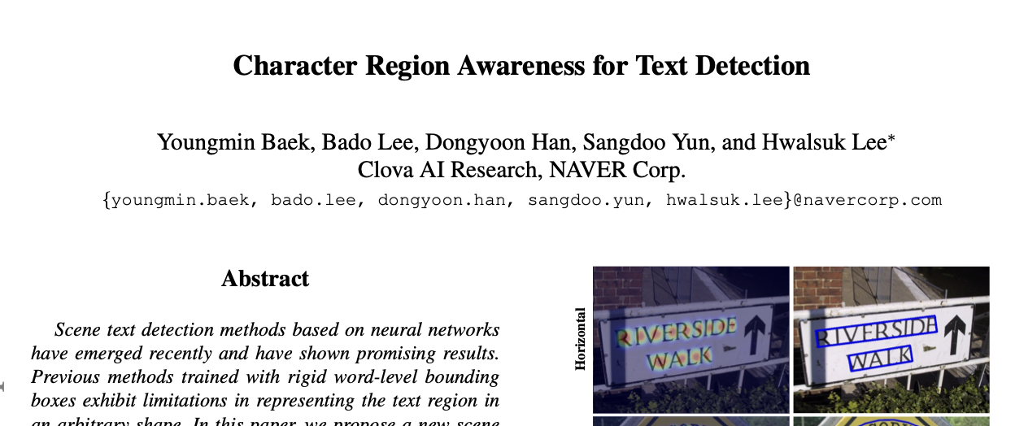
Character detection
The most common biometric data one can think of is Vehicular number plates, mobile numbers, account number etc. Basically any kind of characters.
To solve the character detection problem we employ a pretrained model based on the CRAFT(Character Region Awareness for Text Detection)
It uses a weakly supervised learning technique to train a Deep Neural net over the VGG-16 architecture.
It returns the four corners of bounding boxes created over each detected character section.
Notes:
Raghav

Slide 9
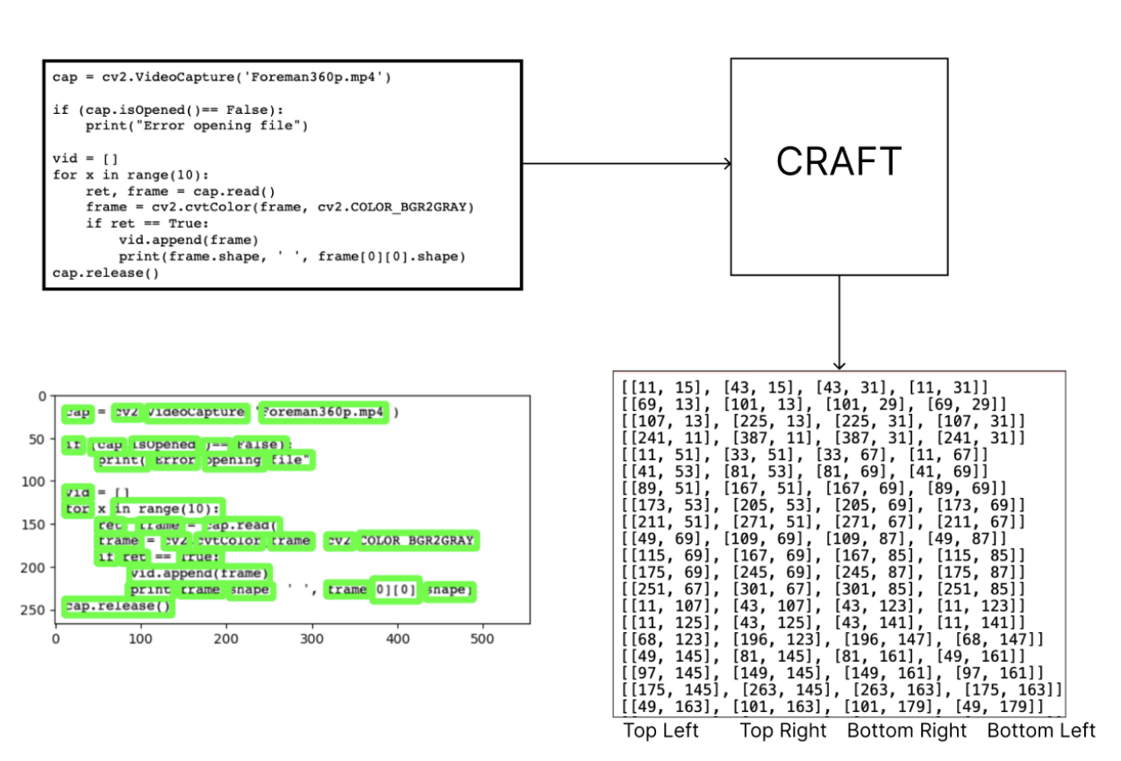
Notes:
Raghav

Slide 10
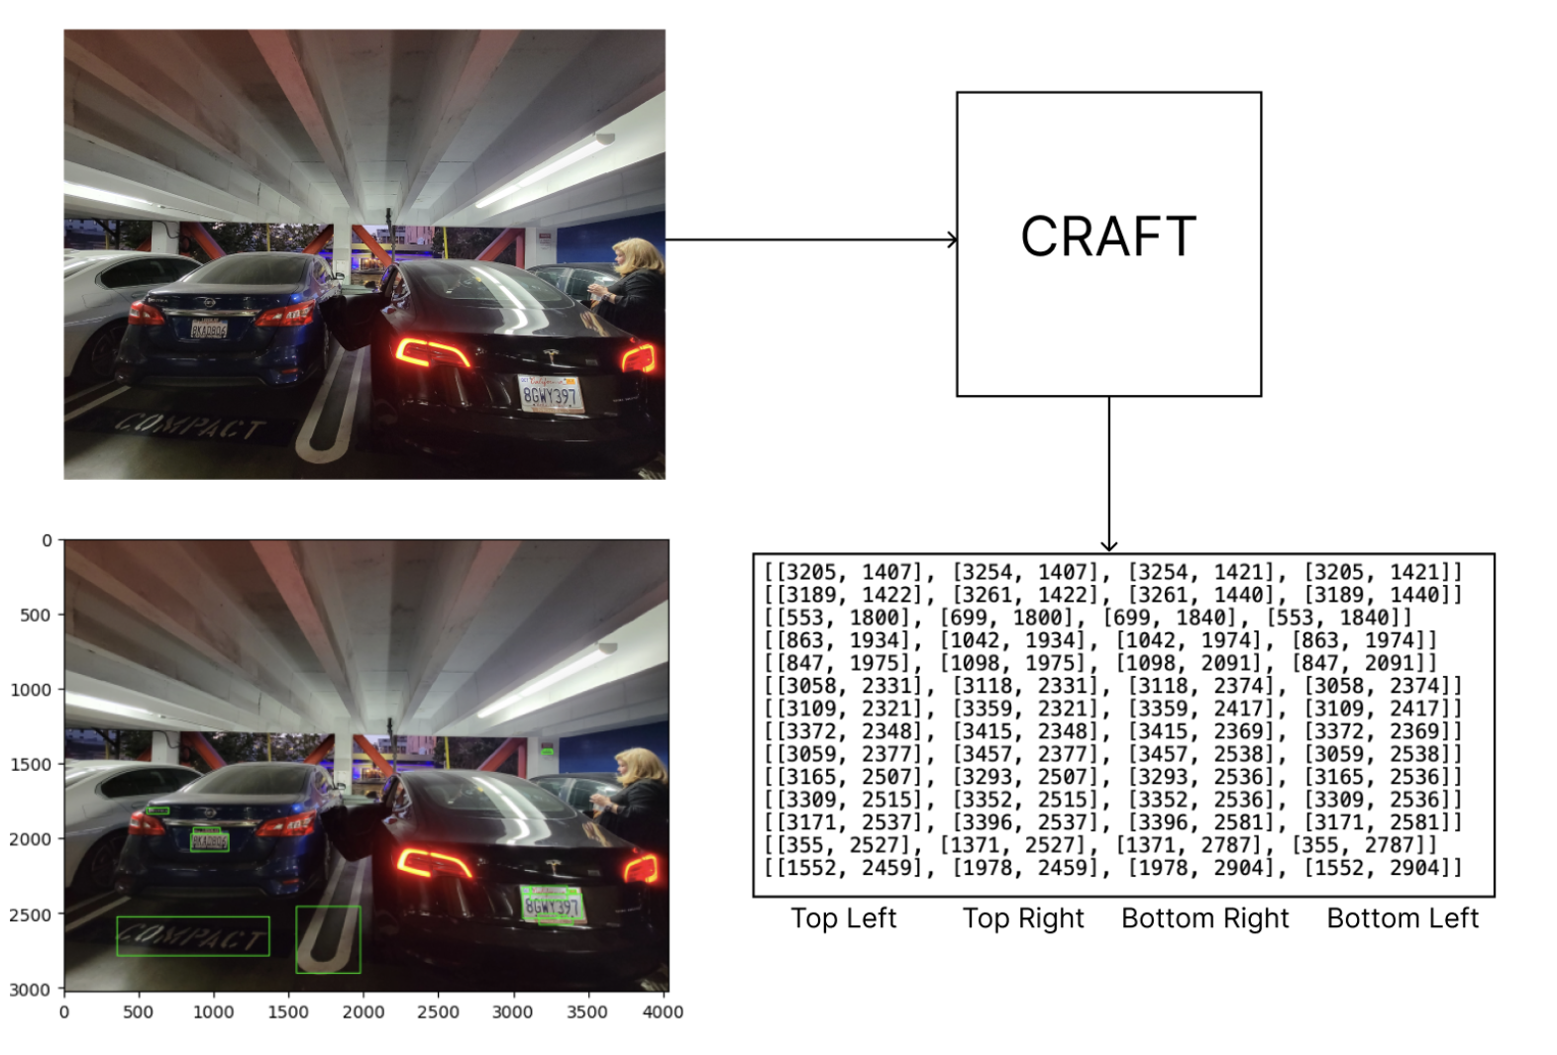
Notes:
Raghav

Slide 11
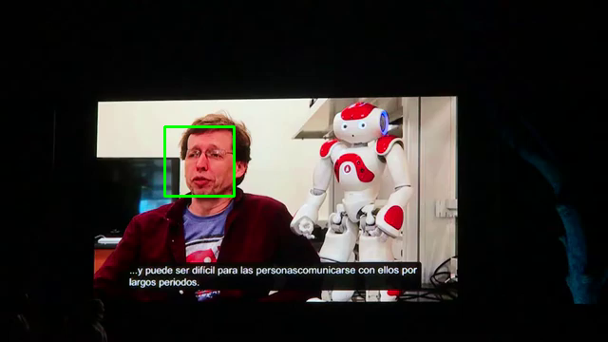
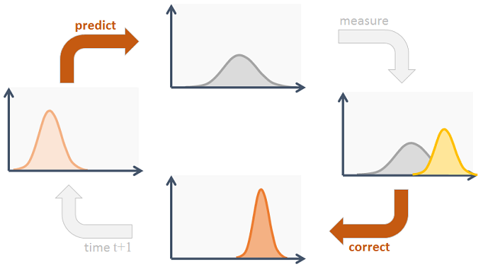
Improve Tracking performance: Kalman filter
T
The cycle of Kalman filter
Notes:
Jisoo https://www.codeproject.com/Articles/865935/Object-Tracking-Kalman-Filter-with-Ease

Slide 12
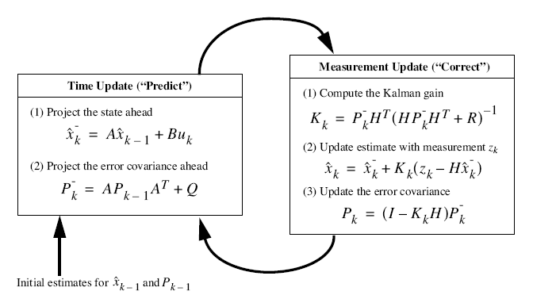
Kalman Filter

Slide 13
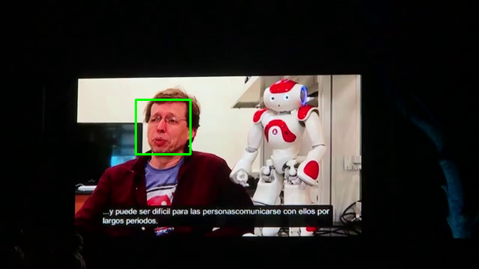
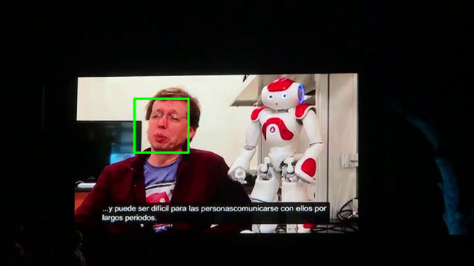
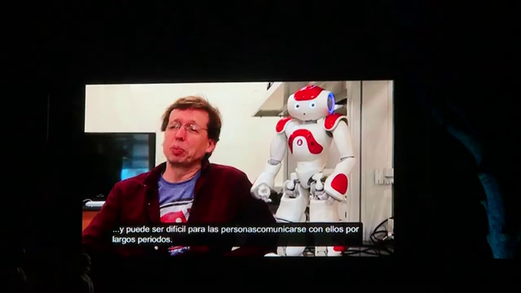
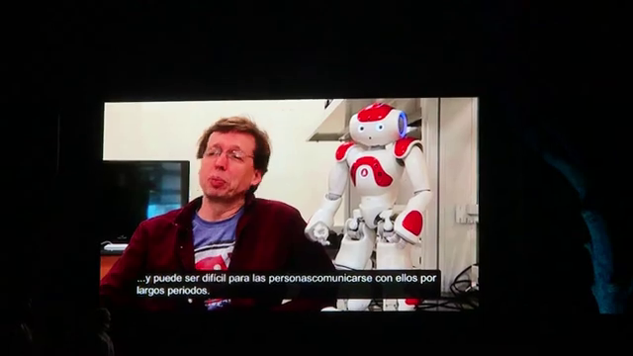
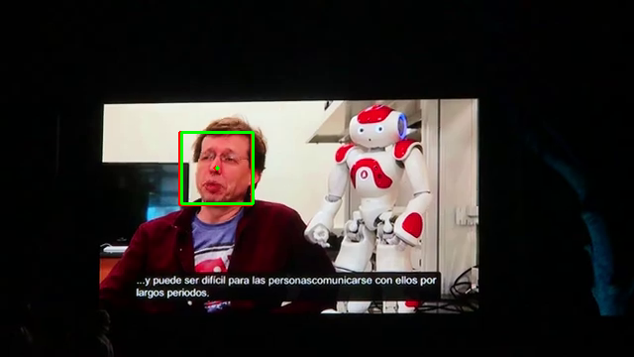

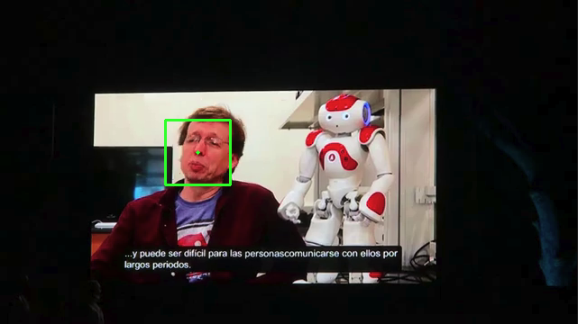
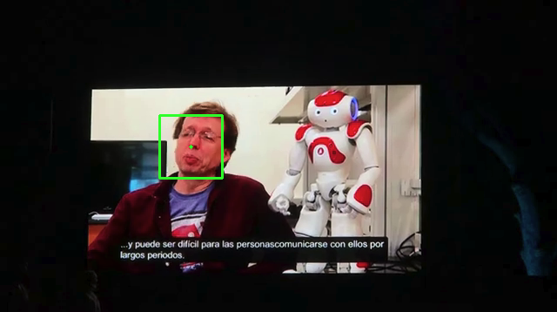
Improve Tracking performance: Kalman filter
frame06
frame07
frame08
frame09
Face detection
Face detection + Kalman filter
source: https://www.youtube.com/watch?v=35usdGuaxoU
Notes:
Jisoo

Slide 14
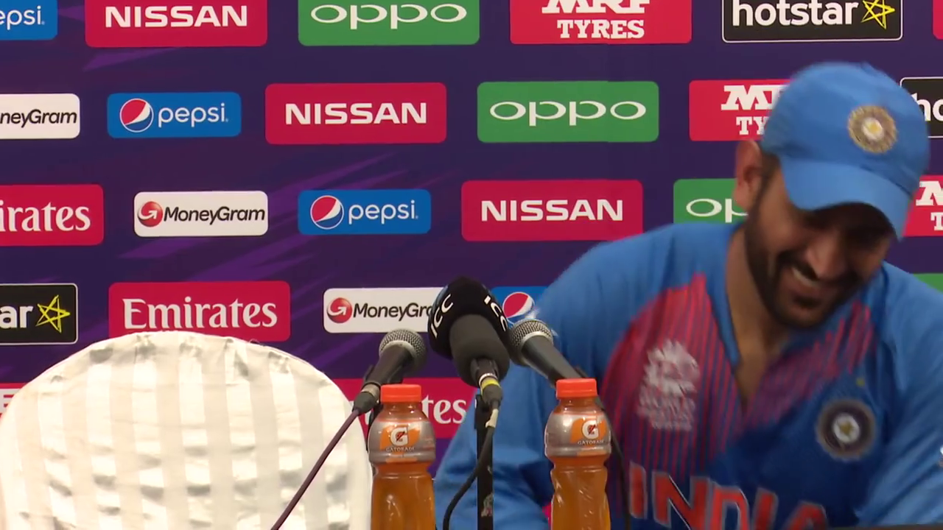
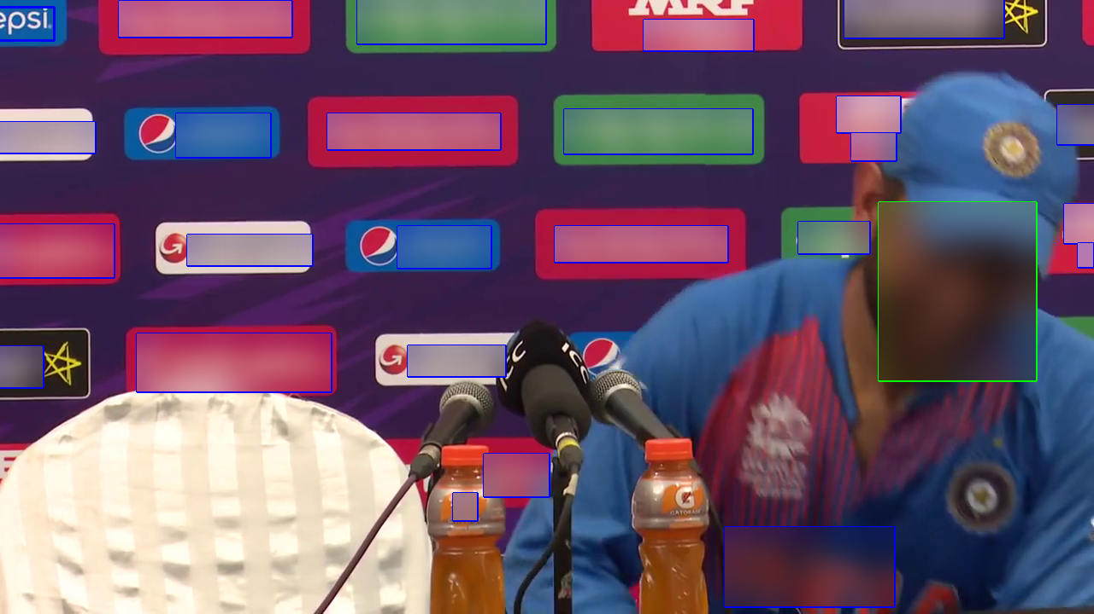
Concealing sensitive information
Once we have the coordinates of all the sensitive information in the frame we apply a gaussian filter to those areas.
Notes:
kuriakose

Slide 15
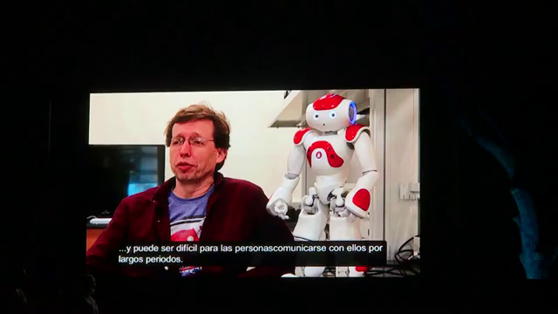

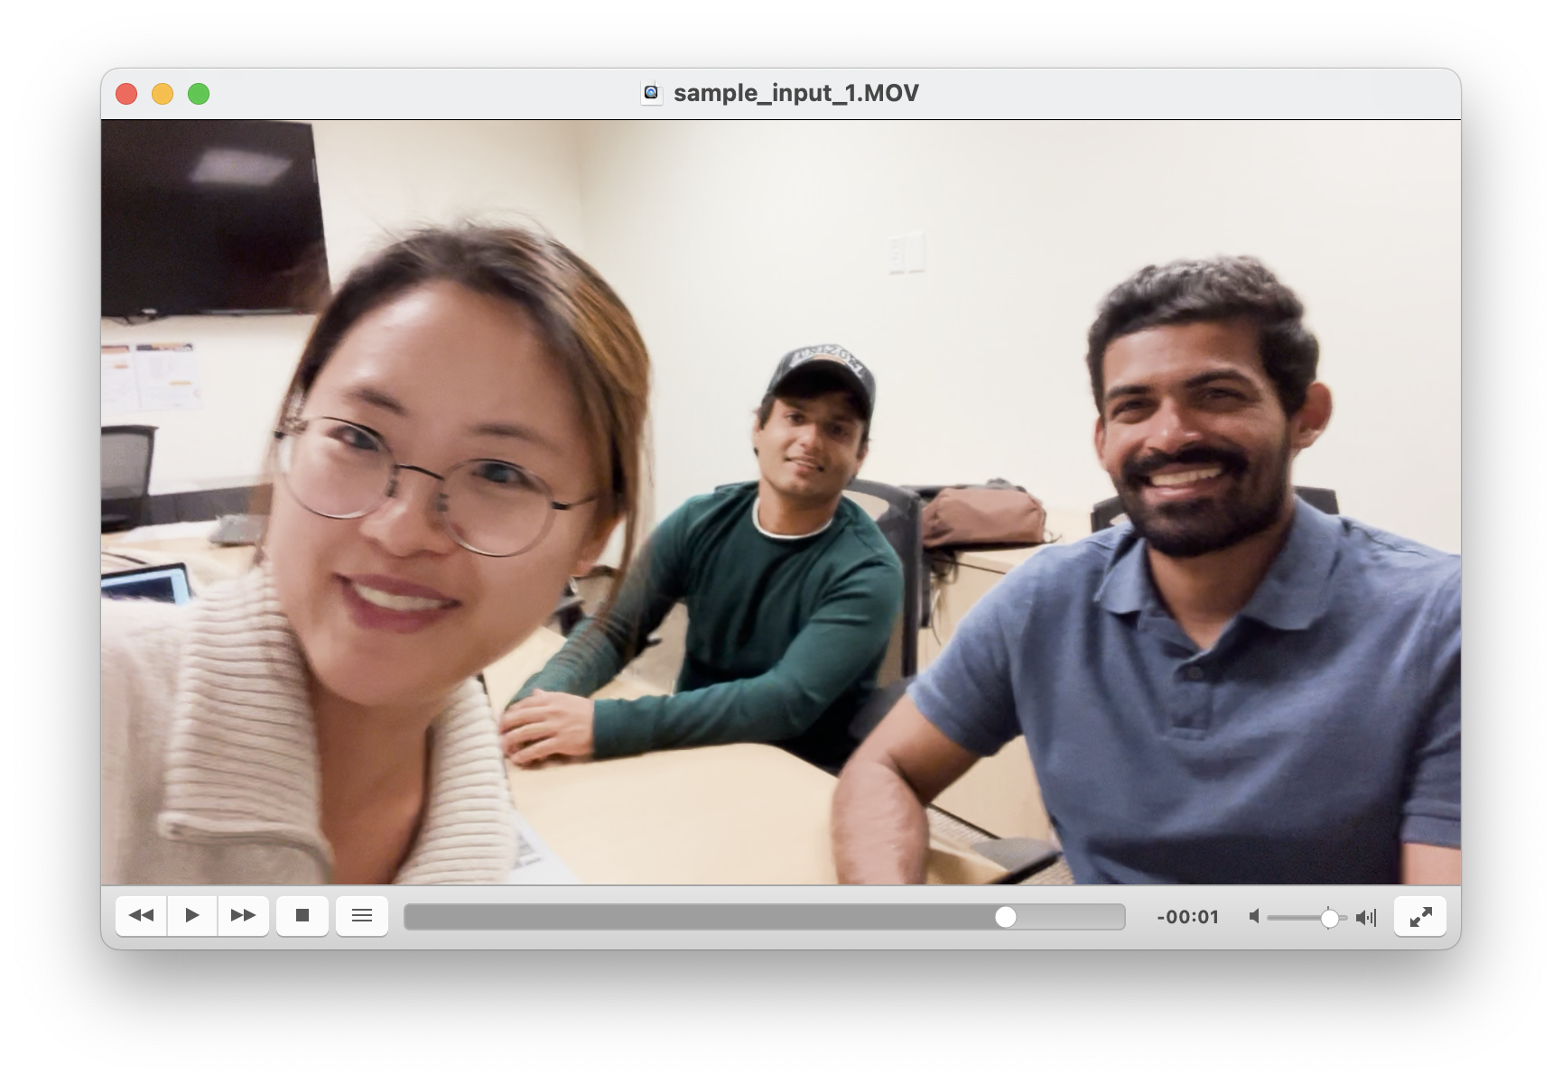
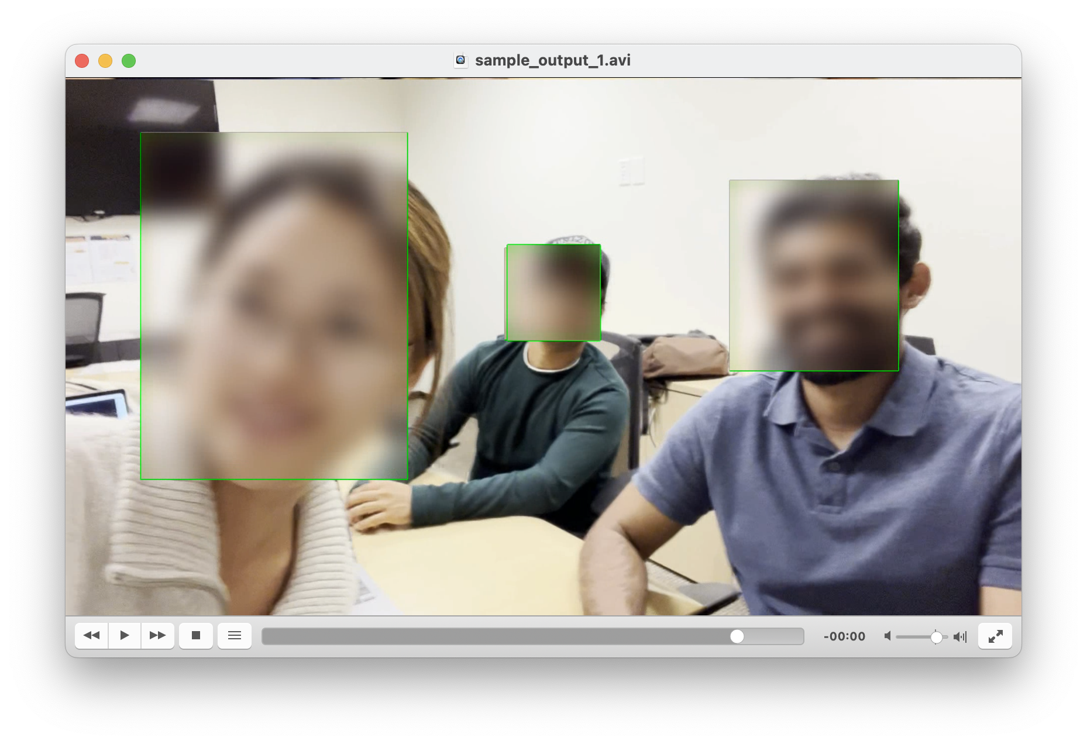
Image results
Notes:
kuriakose

Slide 16
Video Demonstration
Sample Input 1 Sample Output 1
Sample Input 2 Sample Output 2
Sample Input 3 Sample Output 3
Notes:
Input video & output video compare - kuriakose

Slide 17
Further improvements
Real time performance:
Currently, our project isn’t fast enough to render frames real time because of the heavy computations running. We plan to further expand on this and try finding the correct balance between processing time and accuracy and try taking this real time.
Identify other sensitive information like logos, screens etc:
The identification is limited to characters and faces as of now, however there exists other sensitive data in our day to day life, such as logos, screens, etc.
Notes:
We may apply better model for detection, or we can train the one model that detects faces and characters / real time / targeted blurring (identification)
Raghav

Slide 18
Targeted blurring (Identification):
Object detection has two parts: localization and recognition. We have focused only of localization as that was our intent while conceptualising the result. However, specific targeted blurring or certain faces or texts can also be done if we include recognition in this as well.
Better accuracy for fast moving objects:
The system struggles to handle fast moving objects that keep coming in and going off screen. It needs better handling for motion blur.

Slide 19
Thank You
Q&A

